Slide 1
The Complexity and ”Entropy” of EEG Signal
Neuroinformatics
13th April 2005
Milla Ylinaatu

Slide 2
Outline
Background
EEG
Entropy
-Approximate entropy
-Shannon entropy
-Tsallis entropy
Applications
References

Slide 3
Background (1)
Why this topic?
  No real background of neuroinformatics
  Signal processing project work, spring 2004
    topic: 128- channel EEG analysis
    target: to implement methods like entropy and to study how useful they are in recognizing certain features, differing from the normal signal

Slide 4
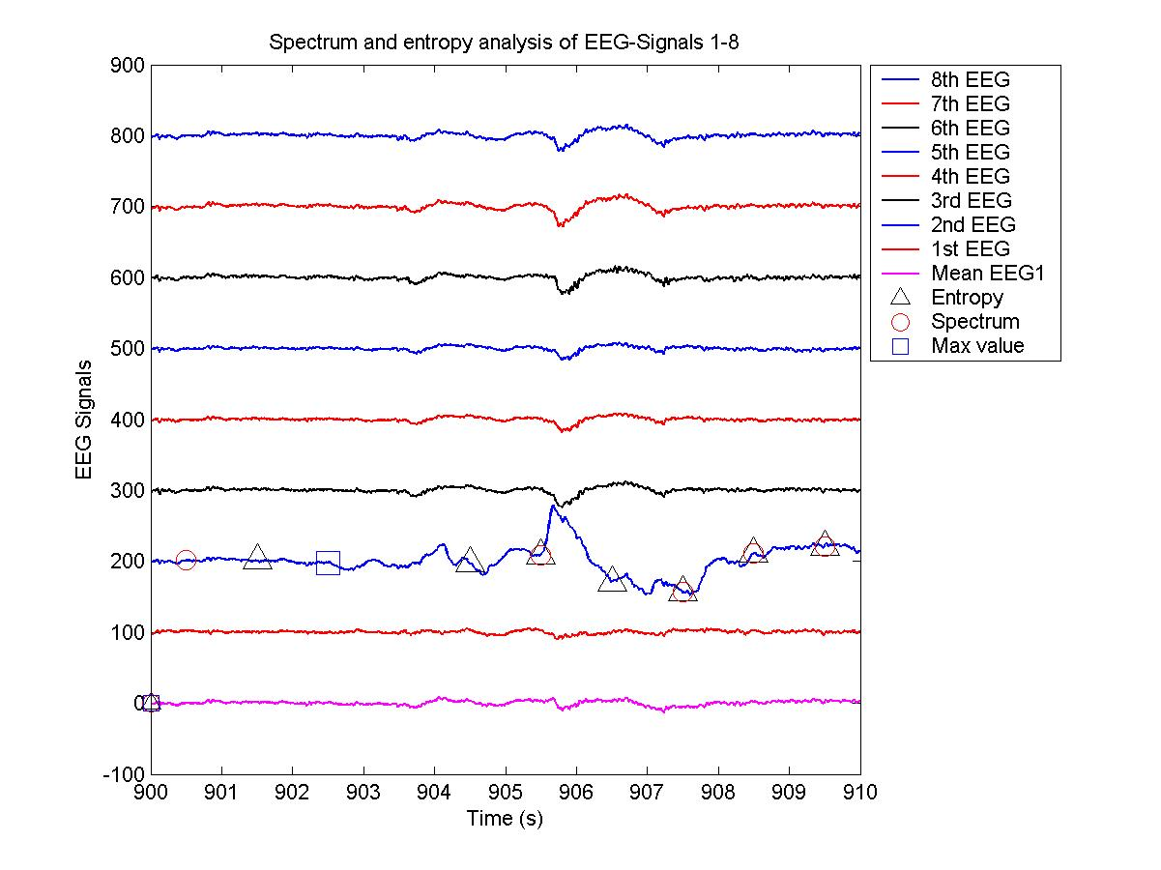
In this figure, the filtered EEG-signals from the left hemisphere compared to mean signal from that hemisphere are shown. As it can be seen the methods find the local brain activations and spatial artefacts from the second EEG-channel.

Slide 5
EEG
Discovered by Berger 1929
is one of the most important neuroelectrical signals
is often used to detect brain's neuroelectrical dysfunction, especially before the focus is formed
(Huupponen, 2002)

Slide 6
EEG (3)
  Reflects the brain potentials generated as a summation of postsynaptic potentials of drendrites of cortical neurons
  Describes the net effect of millions of neurons
  Correlates to different states of consciosness

Slide 7
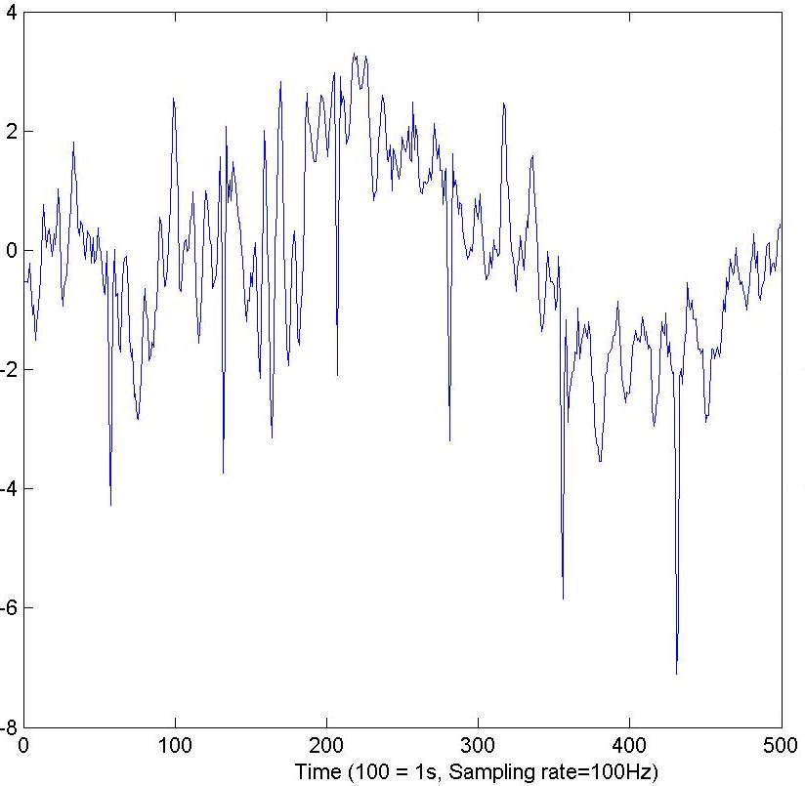

Slide 8
EEG (3)
EEG Signal
  Is usually recorded using standard electrode positions of the 10-20 system
  The most interesting frequency ranges of EEG signals are
    awake signal 0.5-20Hz
    asleep signal 0.5-40Hz
(Huupponen, 2002)

Slide 9
EEG (4)
commonly used signal processing methods is based on the assumption that EEG arises from a linear and stationary process
Since the middle of the 1980s, some scientists have tried to analyze and study the EEG time series by means of nonlinear theory
This brings a new way to us to understand the EEG.

Slide 10
Entropy
Measures signal complexity
EEG with low entropy is due to a small number of dominating processes
EEG with high entropy is due to a large number of processes
(Huupponen, 2002)

Slide 11
Approximate Entropy
Relatively simple measure of complexity and system regularity
Quantifies the predictability of subsequent amplitude values of the EEG based on the knowledge of previous amplitude values
As a relative measure depends on three parameters
    The length of the epoch
    The length of the compared runs
    The filtering level (Bruhn, 2000)

Slide 12
Approximate entropy (2)
is a statistical instrument initially designed to be applied to short and noisy time series data, it is scale invariant and model independent, evaluates both dominant and subordinant patterns in data, and discriminates series for which clear feature recognition is difficult.
(Liyu, 2004)

Slide 13
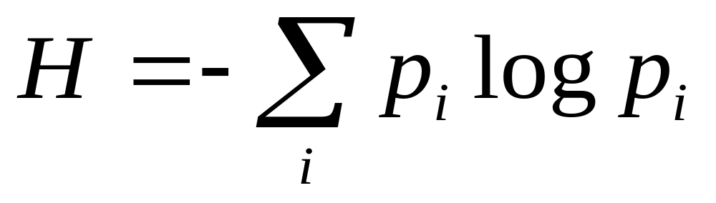
Shannon Entropy
Quantifies the probability density function of the distribution values

Slide 14
Approximate entropy and Shannon entropy are two entirely different measures
Approximate entropy measures the predictability of future amplitude values of the EEG based on the one or two previous amplitude values
Shannon entropy measures the predictability of future amplitude values of the EEG based on the probability distribution of amplitude values already observed in the signal
(Bruhn, 2001)

Slide 15
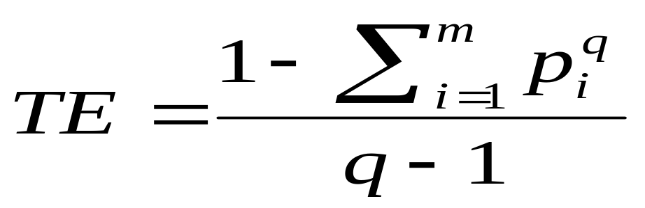
Tsallis entropy
effective as a measure of nonextensive entropy
successful in describing systems with long-range interactions, multifractal space–time constraints or long-term memory effects (Tonga, 2002)

Slide 16
Applications..
In the measurement of the depth of anesthesia
In the measurement of dysfunction of brain
Recovery of brains after dysfunction

Slide 17
Approximate entropy (3)
Increasing anesthetic concentrations are associated with increasing EEG pattern regularity
EEG approximate entropy decreases with increasing anesthetic consentration
At high doses of anesthetics, periods of EEG silence with intermittent bursts of high frequencies occur
For example median EEG frequency method fail to characterize consentrations because of these bursts
(Bruhn,2000)

Slide 18
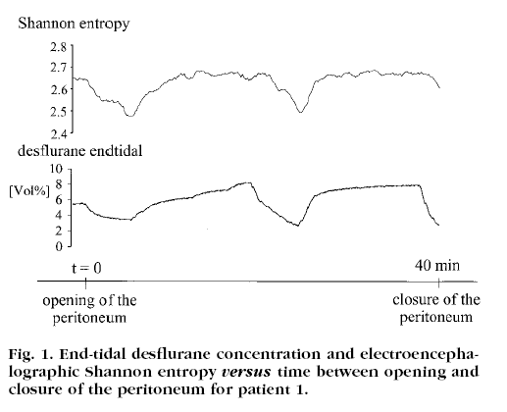
Shannon entropy (2)
Shannon entropy increases with increasing anesthetic concentration
(Bruhn, 2001)

Slide 19
For quantification of depth of anesthesia, high artifact robustness and both interindividual and intraindividual baseline stability (minimal variability in the absense of drug between and within the individuals) are essential
Without artifact rejection Shannon entropy has highest signal-to-noise ratio (SNR)
After artifact rejection both Shannon and approximate entropy have high SNR
Baseline stability within and between the individuals is highest for approximate entropy
(Bruhn, 2002)

Slide 20
Approximation entropy (4)
brain's EEG approximation entropy value is a good candidate for characterizing different extents of cerebral ischemic injury
  First, in the early stage of ischemia, the EEGs’ approximate entropy difference between ischemic region and normal region increase.
  Second, after ischemia 18 minutes, the approximate entropy of ischemic region become lower than that before ischemia (normal state), which may indicate an emergent injury being induced
  Last, the approximate entropy of ischemic region (left brain) is lower than that of normal region (right brain).
(Liyu, 2004)

Slide 21
Tsallis entropy
The nonextensive entropy provides a novel statistical description of the brain rhythms during asphyxic cardiac (ACA) arrest and recovery
ACA brainin jury results ina decrease inen tropy while a good electrophysiological recovery shows a rapid return to a higher entropy level.
(Tonga, 2002)

Slide 22
References
Bruhn, Jörgen et al. Electroencephalogram Approximate Entropy Correctly Classifies The Occurence of Burst Suppression Pattern as Increasing Anesthetic Drug Effect, Anesthesiology 2000; 93:981-5
Bruhn, Jörgen et al. Shannon Entropy Applied to the Measurement of the Electroencephalographic effects of Desflurane, Anesthesiology 2001; 95:30-5
Bruhn, Jörgen et al. Artifact Robustness, Inter- and intrandividual Baseline Stability, and Rational EEG Parameter Selection, Anethesiology 2002; 96:54-9
Huupponen, Eero, Advances in the Detection of Sleep EEG Signal Waveforms, Tampereen Teknillinen korkeakoulu, julkaisuja 380, 2002
Liyu Huang, Approximate entropy of EEG as a Measure of Cerebral Ischemic Injury, Proceedings of the 26th Annual International Conference of the IEEE EMBS, San Francisco, CA, USA • September 1-5, 2004
Tonga S, Nonextensive entropy measure of EEG following
brainin jury from cardiac arrest, Physica A 305 (2002) 619 – 628

Slide 23

Thank You!
Questions?

